Slide 1
ACT 241 CAPITAL IMPROVEMENTS PROGRAM (CIP) PROJECT TRAINING
December 5, 2017
9:00 – Introduction
9:15 – Planning Phase
9:45 – Design/Permitting Phase
10:30 – Break
10:45 – Bidding Phase
11:00 – Construction Phase
11:30 – Post Construction/Warranty Phase
11:45 – Wrap up/Questions

Slide 2
ACT 241 CAPITAL IMPROVEMENTS PROGRAM (CIP) PROJECT TRAINING
December 5, 2017
Act 241, SLH 2016
Roderick K. Becker
COMPTROLLER
Department of
Accounting and General Services

Slide 3
DAGS TRADITIONAL ROLE
DAGS is the centralized engineering agency in the State including operation and maintenance of public buildings for departments of the State (HRS Section 26-6)
In the past, airport, highways, harbors, and housing projects have been managed by their respective agencies.

Slide 4
CIP PROJECTS IN OTHER STATE AGENCIES
Over the years, various Departments have created engineering functions and taken over their own CIP projects for a variety of reasons. (UH, DOE, etc.)
Act 177, SLH 2015 – “The legislature finds that there are great inconsistencies and a general lack of accountability in the management and construction of government capital improvement projects.”

Slide 5
AUDITOR’S REPORT
Act 177, SLH 2015. Directs Auditor to:
  Determine if it serves the public interest to be decentralized and have duplicative engineering functions.
  To review the process, efficiencies, and accountability of various departmental engineering sections that manage capital improvement projects.
Implementation of this measure will provide transparency and ensure accountability in the management and construction of government capital improvement projects.

Slide 6
FINDINGS OF STATE AUDITOR (WHAT WORKS)
  Decentralized engineering sections continue to serve the public’s interest.
  DAGS doesn’t have the capacity nor the specialized skill to handle the variety of projects undertaken statewide.
  Concluded that it would not be in the public’s best interest to require that DAGS manage all State-funded CIPs.

Slide 7
FINDINGS OF STATE AUDITOR (AREAS OF IMPROVEMENT)
Departments and agencies manage their CIP Projects to varying standards.
    More than one-third of departments and agencies that manage their own general-funded CIP Projects do not keep timelines as required by best practices.
    They do not consistently track contract deliverables and payments as recommended by State Procurement Office (SPO) guidance.
    Almost half of departments and agencies do not measure or monitor stakeholder satisfaction when managing their CIP Projects.

Slide 8
REASON FOR TRAINING BY DAGS
DAGS is the State centralized engineering agency and was found to adhere to best practices as determined by the Auditor regarding:
  Timelines
  Payment Tracking
  Stakeholder involvement
Act 241, SLH 2016. Implement findings of Auditor by having DAGS conduct annual training for the engineering personnel of all executive departments and state agencies that manage their own CIP Projects.
Each Department and Agency shall provide orientation training for new employees in addition to ensuring engineering personnel receive annual training.

Slide 9
BENEFITS OF TRAINING
PUBLIC CONFIDENCE: Adopting standards that adhere to best practices would likely enhance public confidence in the State’s management of its multi-million dollar CIP projects.
UNIFORM EXPECTATION: Creating uniform expectations among different State Departments will assist in executing oversight on CIP expenditures.

Slide 10
MAHALO
Roderick K. Becker
COMPTROLLER
Department of
Accounting and General Services

Slide 11
Planning
Chris Kinimaka
DAGS public works division
Planning braNCH

Slide 12
Warm up
Sustainability Exercise

Slide 13
Training concepts
10,000 foot level overview of typical CIP Projects
Basic steps regardless of agency organization (silo vs. cradle-to-grave)
Continuous Improvement
Kona Judiciary timeline due to project complexity
Not all projects need all steps

Slide 14
Planning for CIP projects
The Birth of a Project
Key Planning Requirements
Project Life After Planning

Slide 15
Planning for cip projects
The Birth of a Project: Risk Management
  Identify Issues Early
    Costs for Correction:
    Planning = $1; Design = $100; Construction = $10,000
  Anticipate and Plan Mitigative Actions for Risks
  Continuously Monitor, Adjust, Refine

Slide 16
Planning for cip projects
The Birth of a Project
  Project Stakeholders – Roles, Responsibilities, Relationships
    Memorandum of Understanding
    Tri-Party Contracts
    Contract Encumbrance/Payment Processing
    Project Approvals
    Travel Arrangements

Slide 17
Planning for cip projects
SCOPE
SCHEDULE
The Birth of a Project:
  Identify Project Triangle: Scope – Schedule – Budget
    Sets Project Expectations, Timelines, and Constraints
    Cannot change one “leg” without affecting the others
      As scope/quality increases, or schedule is shortened, budget must increase.
      As budget is reduced, scope/quality may be reduced or schedule lengthened.
    Defining the Triangle is an Iterative and Continuous process.
$$$

Slide 18
Planning for CIP projects
The Birth of a Project
What is a Capitol Improvement Program (CIP) Project?
  From Budget Execution Policy: EM 99-01/EM 97-07
  Improvements/Upgrades Increase the Asset Value of the Facility/Installation
  Useful Life of Improvements/Upgrades Exceed Bond Life (10 - 15+ Years)
  Renovation & Alteration vs. Repair & Maintenance
  Equipment/Furniture is Built-in, Non-position Related, or Not Portable

Slide 19
Planning for cip projects
The Birth of a Project
  Sources of Funding
    GO Bond Funds or General Funds
    Federal Funding – Additional Reporting & Audit Requirements; Section 106 Environmental Review
    Other/Special Funds
    Affects Project Schedule (funds deadlines/lapse dates)

Slide 20
Planning for cip projects
The Birth of a Project
  Project Initiation and Release of Funds
    State Funds
      Appropriation Language – Table R
      Allotment Request – EM 99-01/EM 97-07
    Consultant Selection
  Project Cost and Schedule

Slide 21
Table R: capital project information and Justification sheet
Required for all Executive Budget CIP Projects
Determines Legal Project Title & Description [See Handout]
Provides full breakout of past, current, and future funding
Provides narrative justification for the project
Table R determines future use of project appropriations!

Slide 22
Table R: capital project information & Justification

Slide 23
Table R: capital project information & Justification

Slide 25
Planning for cip projects
The Birth of a Project
  Project Initiation and Release of Funds
    State Funds
      Appropriation Language – Table R
      Allotment Request – EM 99-01/EM 97-07
    Consultant Selection
  Project Cost and Schedule

Slide 26
Allotment Request – EM 99-01/EM 97-07
Annual Budget Execution Policy “renews” this Executive Memorandum
Ultimate Guide for Executive Branch funding actions requiring Department of Budget & Finance (DB&F) and/or Governor’s approval

Slide 28
Planning for cip projects
The Birth of a Project
  Project Initiation and Release of Funds
    State Funds
      Appropriation Language – Table R
      Allotment Request – EM 99-01/EM 97-07
    Consultant Selection [HRS §103D-304;
    HAR §3-122-Subsection 7]
  Project Cost and Schedule

Slide 29
Planning for cip projects
The Birth of a Project
  Project Initiation and Release of Funds
    State Funds
      Appropriation Language – Table R
      Allotment Request – EM 99-01/EM 97-07
    Consultant Selection [HRS §103D-304;
    HAR §3-122-Subsection 7]
  Project Cost and Schedule

Slide 30
Planning for cip projects
Project Cost and Schedule
  Include all project phases and “hidden” costs
  Use established guides and historic data
  Account for special conditions
  (See sample Tables A-8a & B1a)

Slide 31
Planning for cip projects
Key Planning Requirements – Flow Chart and Sample Timeline
  Project Development Report
  Land Entitlements
    Site Selection
    Environmental Assessment/Environmental Impact Statement
    Acquisition/Lease
    Easements
    ROE

Slide 32
Planning for cip projects
Key Planning Requirements (continued)
  Land Entitlements
    Historic/Cultural Review (Section 106, 6E) – Architectural, Archeological, Cultural Organizations, Burial Council (See Presentation Excerpt)
    Zoning/Permitting – State & Counties (PRU, SMP, CON, SUP, CDUA, etc.)
    Other Public Review and Community Outreach

Slide 33
Planning for cip projects
Key Planning Requirements (continued)
  Add’l Planning Studies (Infrastructure, traffic, soils, etc.)
  Funding for Future Project Phases
    Timing of Appropriations with Lapse Dates
  Refinement of the Project Triangle for Design
SCOPE
SCHEDULE
$$$

Slide 34
Planning for cip projects
Project Life After Planning
  Continue on to Design/Construction
  Possible continued role for Land/Entitlement work, program coordination, and additional funding
  Stand-alone Studies and Reports

Slide 35
Mahalo!

Slide 36
Act 241/SLH 2016
CAPITAL IMPROVEMENT
PROJECT TRAINING
December 5, 2017
(Final Draft)
DESIGN PHASE

Slide 37
Capital Improvement Project Training
Design Phase
DISCUSSION ITEMS
DAGS PUBLIC WORKS DIVISON
POLICIES & PROCEDURES GOVERNING DESIGN CONSULTANT CONTRACTS, NOV. 1981, AS REVISED
DESIGN CONSULTANT CRITERIA MANUAL (a.k.a. DCC Manual or DCCM)
INTERIM GENERAL CONDITIONS, 1999, AS REVISED
PROJECT DESIGN DELIVERY PROCESS
STANDARD FORMS

Slide 38
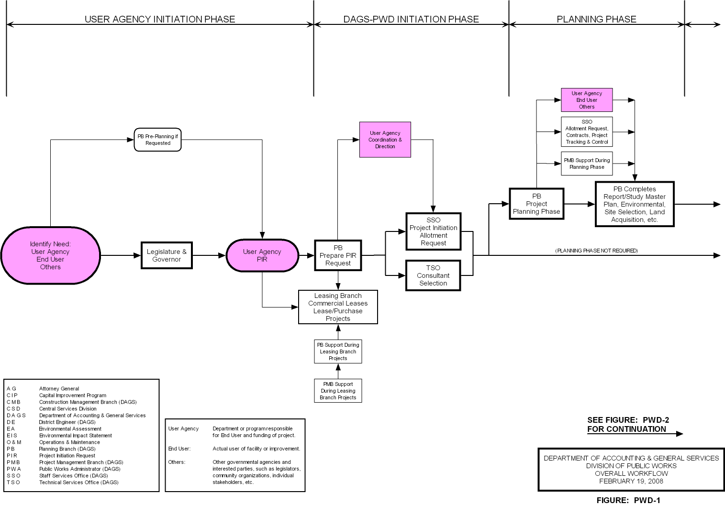
PROJECT DELIVERY PROCESS FLOW
DAGS – Public Works Division

Slide 39
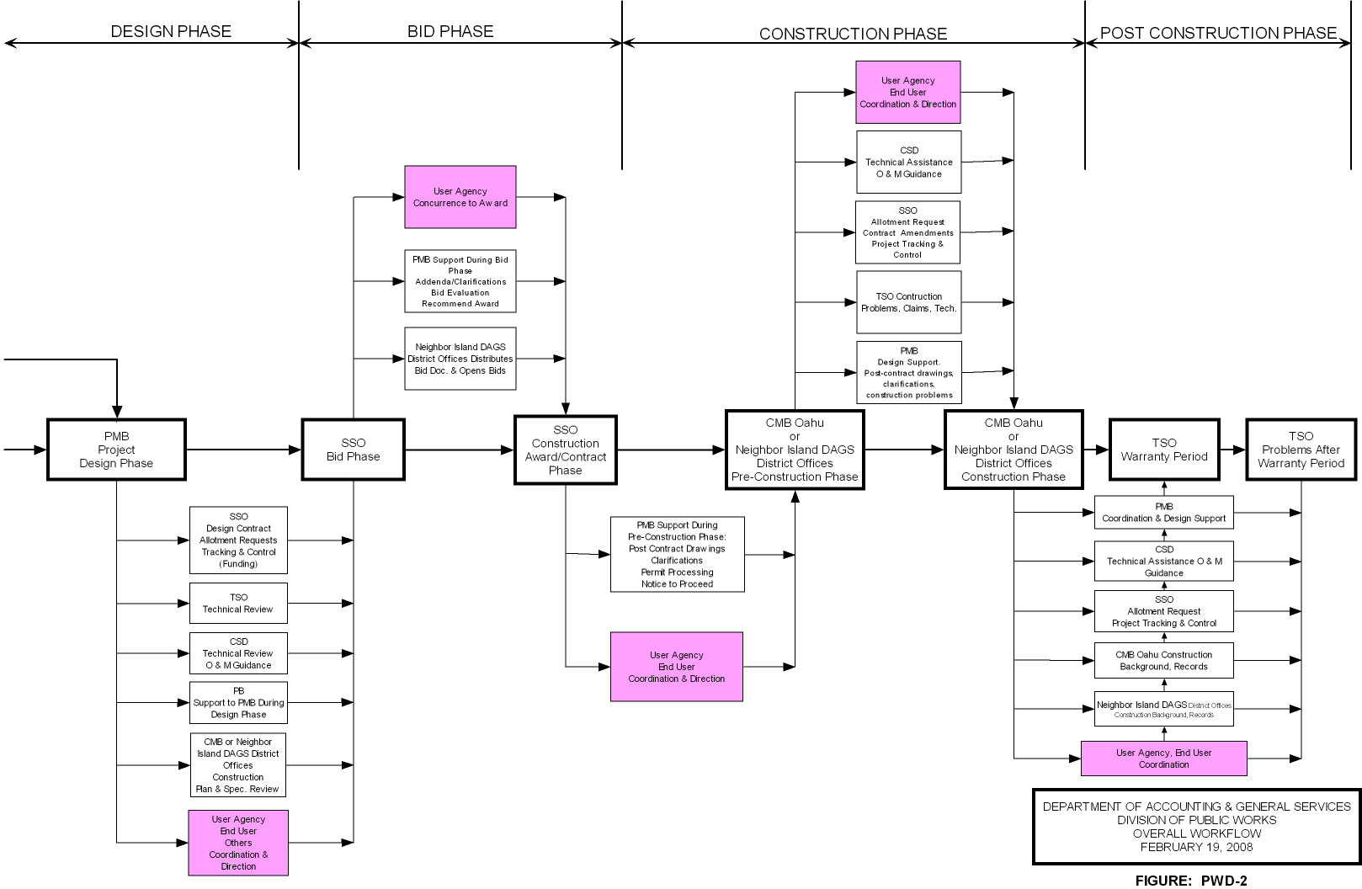
PROJECT DELIVERY PROCESS FLOW
DAGS – Public Works Division

Slide 40
CAPITAL IMPROVEMENT PROJECT TRAINING
DAGS – Public Works Division
POLICIES & PROCEDURE GOVERNING DESIGN CONSULTANT CONTRACTS
November 1981, As Revised
Part of Consultant’s contract
Defines design submittals and other requirements for the various project phases for a typical project.
  Schematic Design Phase
  Preliminary Design Phase
  Final Design Phase
    Pre-final submittal
    Final submittal
  Bidding Phase
  Construction Phase
  Additional tasks and/or phases added as required

Slide 41
CAPITAL IMPROVEMENT PROJECT TRAINING
DAGS – Public Works Division
DESIGN CONSULTANT CRITERIA MANUAL
A.k.a. DCC Manual or DCCM
Available on the DAGS Public Works Division Website at: http://hawaii.gov/pwd and click on DCC Manual

Slide 42
CAPITAL IMPROVEMENT PROJECT TRAINING
DAGS – Public Works Division
INTERIM GENERAL CONDITIONS
1999 EDITION AS REVISED
General conditions of the construction contract
Included by reference in the bid documents
Revised by Section 00700 of the specifications
Important to know this document for:
  Coordination and consistency in writing the technical specifications and other sections
  Coordination with User/Stakeholders in understanding the Contractors responsibilities and obligations

Slide 43
CAPITAL IMPROVEMENT PROJECT TRAINING
DAGS – Public Works Division
PROJECT DESIGN DELIVERY PROCESS
DESIGN PHASE
  PMB/Design Phase Initiation
  Schematic Design Phase
  Preliminary Design Phase
  Pre-Final Design Phase
  Final Design Phase
  Bid Phase
  Construction Phase

Slide 44
CAPITAL IMPROVEMENT PROJECT TRAINING
DAGS – Public Works Division
PROJECT DESIGN DELIVERY PROCESS
PMB/Design Initiation Phase
  Review Project Scope, Budget and Schedule
  Coordination Handoff Meeting/Discussion with Planning Branch
  If necessary, have coordination meeting/discussion with User Agency
  Start to identify project risks, requirements and constraints

Slide 45
CAPITAL IMPROVEMENT PROJECT TRAINING
DAGS – Public Works Division
PROJECT DESIGN DELIVERY PROCESS
Schematic Design Phase
  One of the objectives is to investigate possible solutions and RISKS at minimum design expense
  May include conceptual or pre-schematic design phase
  Basis of Design
  Identify other project/design needs such as:
    Topo survey
    Geotechnical investigations
    Hazardous material investigations/testing
    (continued)

Slide 46
CAPITAL IMPROVEMENT PROJECT TRAINING
DAGS – Public Works Division
(continued)
PROJECT DESIGN DELIVERY PROCESS
Schematic Design Phase
  Identify project RISKS, requirements and/or constraints:
    Possible on/off site development requirements
    Utility charges and/or development fees
    Easements, subdivision and other land issues
    Permit and approval requirements
    Chapter 343 HRS – EA/EIS
    Potential for unforeseen conditions
    Project Owner/User/Stakeholder
    Other

Slide 47
CAPITAL IMPROVEMENT PROJECT TRAINING
DAGS – Public Works Division
(continued)
PROJECT DESIGN DELIVERY PROCESS
Schematic Design Phase
  Establish the Design Scope, Budget, Schedule, and Project Risks
    Meeting(s) with User Agency and other Stakeholders as necessary
  Typically 15% construction plans and cost estimates

Slide 48
PROJECT DESIGN DELIVERY PROCESS
DAGS – Public Works Division
Scope, Budget, and Schedule
(User Satisfaction/Stakeholder Involvement)

Slide 49
CAPITAL IMPROVEMENT PROJECT TRAINING
DAGS – Public Works Division
PROJECT DESIGN DELIVERY PROCESS
Preliminary Design Phase
  Objective is to fix and illustrate the size, character and design of the entire project
  Topo survey, geotechnical investigations, and other design needs should be complete
  Completion or status of other project requirements/entitlements
  (continued)

Slide 50
CAPITAL IMPROVEMENT PROJECT TRAINING
DAGS – Public Works Division
(continued)
PROJECT DESIGN DELIVERY PROCESS
Preliminary Design Phase
  Continued assessment of Risks
  Scope, Budget, Schedule and Risks
    Meeting(s) with DAGS, User Agency, and other stakeholders as necessary
  Typically 35% construction plans, outline specifications, and cost estimates

Slide 51
PROJECT DESIGN DELIVERY PROCESS
DAGS – Public Works Division
Scope, Budget, and Schedule
(User Satisfaction/Stakeholder Involvement)

Slide 52
CAPITAL IMPROVEMENT PROJECT TRAINING
DAGS – Public Works Division
PROJECT DESIGN DELIVERY PROCESS
Final/Pre-Final Design Phase
  All phases of construction work is fully shown and described so that the intent is understood by all
  All project requirements and constraints/restrictions have been incorporated into project construction documents
  Completion or status of other project requirements/entitlements
  Building Permit Application
    (continued)

Slide 53
CAPITAL IMPROVEMENT PROJECT
DAGS – Public Works Division
PROJECT DESIGN DELIVERY PROCESS
(continued)
Final/Pre-Final Design Phase
  Risks are manageable
  Scope, Budget, Schedule and Risks
    Meeting(s) with DAGS, User Agency, and other stakeholders as necessary
  Typically 90 – 100 % construction plans, specifications, and cost estimates

Slide 54
CAPITAL IMPROVEMNET PROJECT
DAGS – Public Works Division
PROJECT DELIVERY & PROCESS
(continued)
Final Design Phase
  Incorporate pre-final review comments
  Completion of other project requirements/entitlements
  Scope, Budget, Schedule and Risks
    Meeting(s) with DAGS, User Agency, and other stakeholders as necessary
  100 % construction plans, specifications, and cost estimates

Slide 55
PROJECT DESIGN DELIVERY PROCESS
DAGS – Public Works Division
Scope, Budget, and Schedule
(User Satisfaction/Stakeholder Involvement)

Slide 56
CAPITAL IMPROVEMENT PROJECT TRAINING
DAGS – Public Works Division
PROJECT DESIGN DELIVERY PROCESS
Bid and Award Phase
  Continue to monitor and process building permit and approvals
  Attend pre-bid conference for projects with estimates more than $500,000 or as required
  Addendum Instructions
    Prepare bid addenda
    Substitution requests
    Addendum schedule
    Proper communications
  Analysis of bids
  Scope, Budget, and Schedule
  Award of Construction Contract

Slide 57
PROJECT DESIGN DELIVERY PROCESS
DAGS – Public Works Division
Scope, Budget, and Schedule
(User Satisfaction/Stakeholder Involvement)

Slide 58
CAPITAL IMPROVEMENT PROJECT TRAINING
DAGS – Public Works Division
PROJECT DESIGN DELIVERY PROCESS
Construction Phase
  Notice to Proceed issued upon approval of building permit (Typically)
Scope, Budget, and Schedule

Slide 59
CAPITAL IMPROVEMENT PROJECT TRAINING
DAGS – Public Works Division
Timeline Tracking

Slide 60
CAPITAL IMPROVEMENT PROJECT TRAINING
DAGS – Public Works Division
Timeline Tracking

Slide 61
CAPITAL IMPROVEMENT PROJECT TRAINING
DAGS – Public Works Division
Timeline Tracking

Slide 62
CAPITAL IMPROVEMENT PROJECT TRAINING
DAGS – Public Works Division
Timeline Tracking

Slide 63
CIP PROJECT TRAINING
DAGS – Public Works Division
Timeline Tracking

Slide 64
CAPITAL IMPROVEMENT PROJECT TRAINING
DAGS – Public Works Division
Timeline Tracking

Slide 65
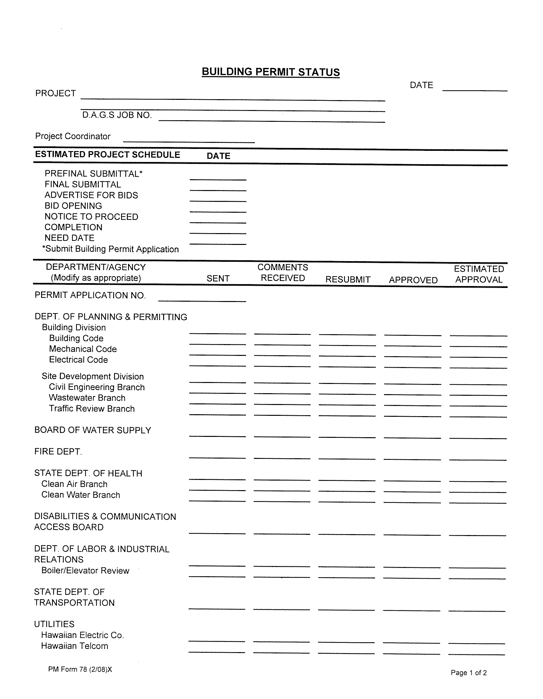
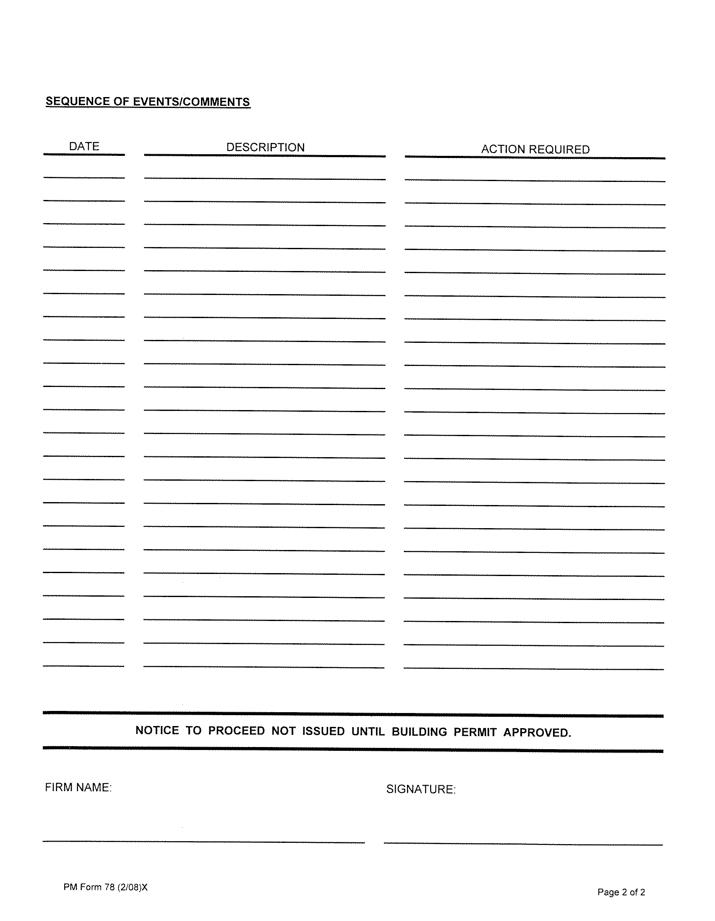
CAPITAL IMPROVEMENT PROJECT TRAINING
DAGS – Public Works Division
Timeline Tracking – Building Permit Status

Slide 66
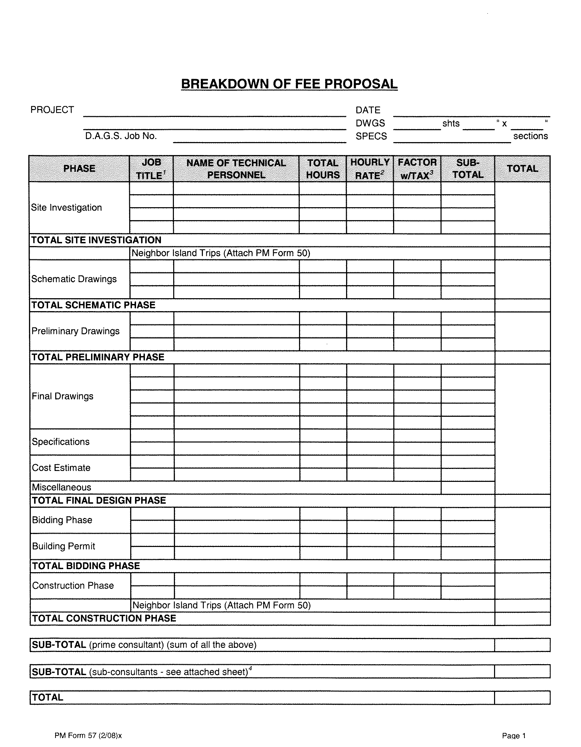
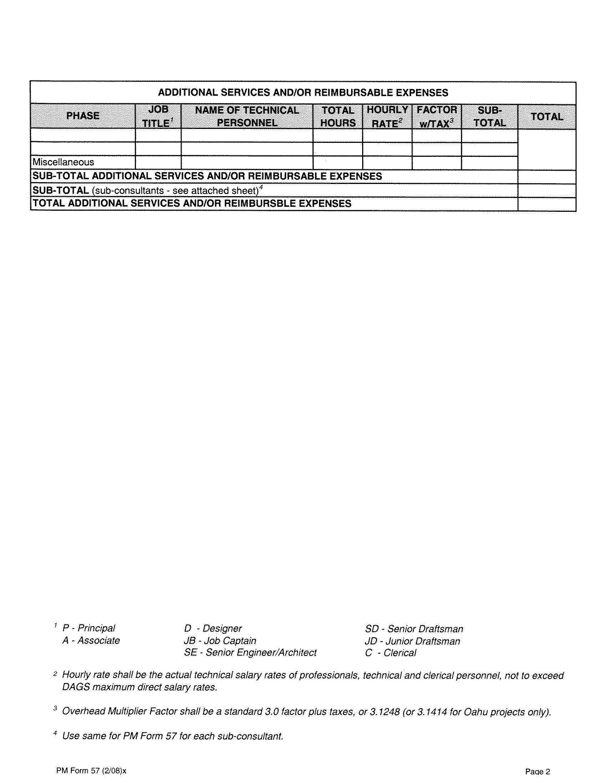
CAPITAL IMPROVEMENT PROJECT TRAINING
DAGS – Public Works Division
Payment Tracking

Slide 67
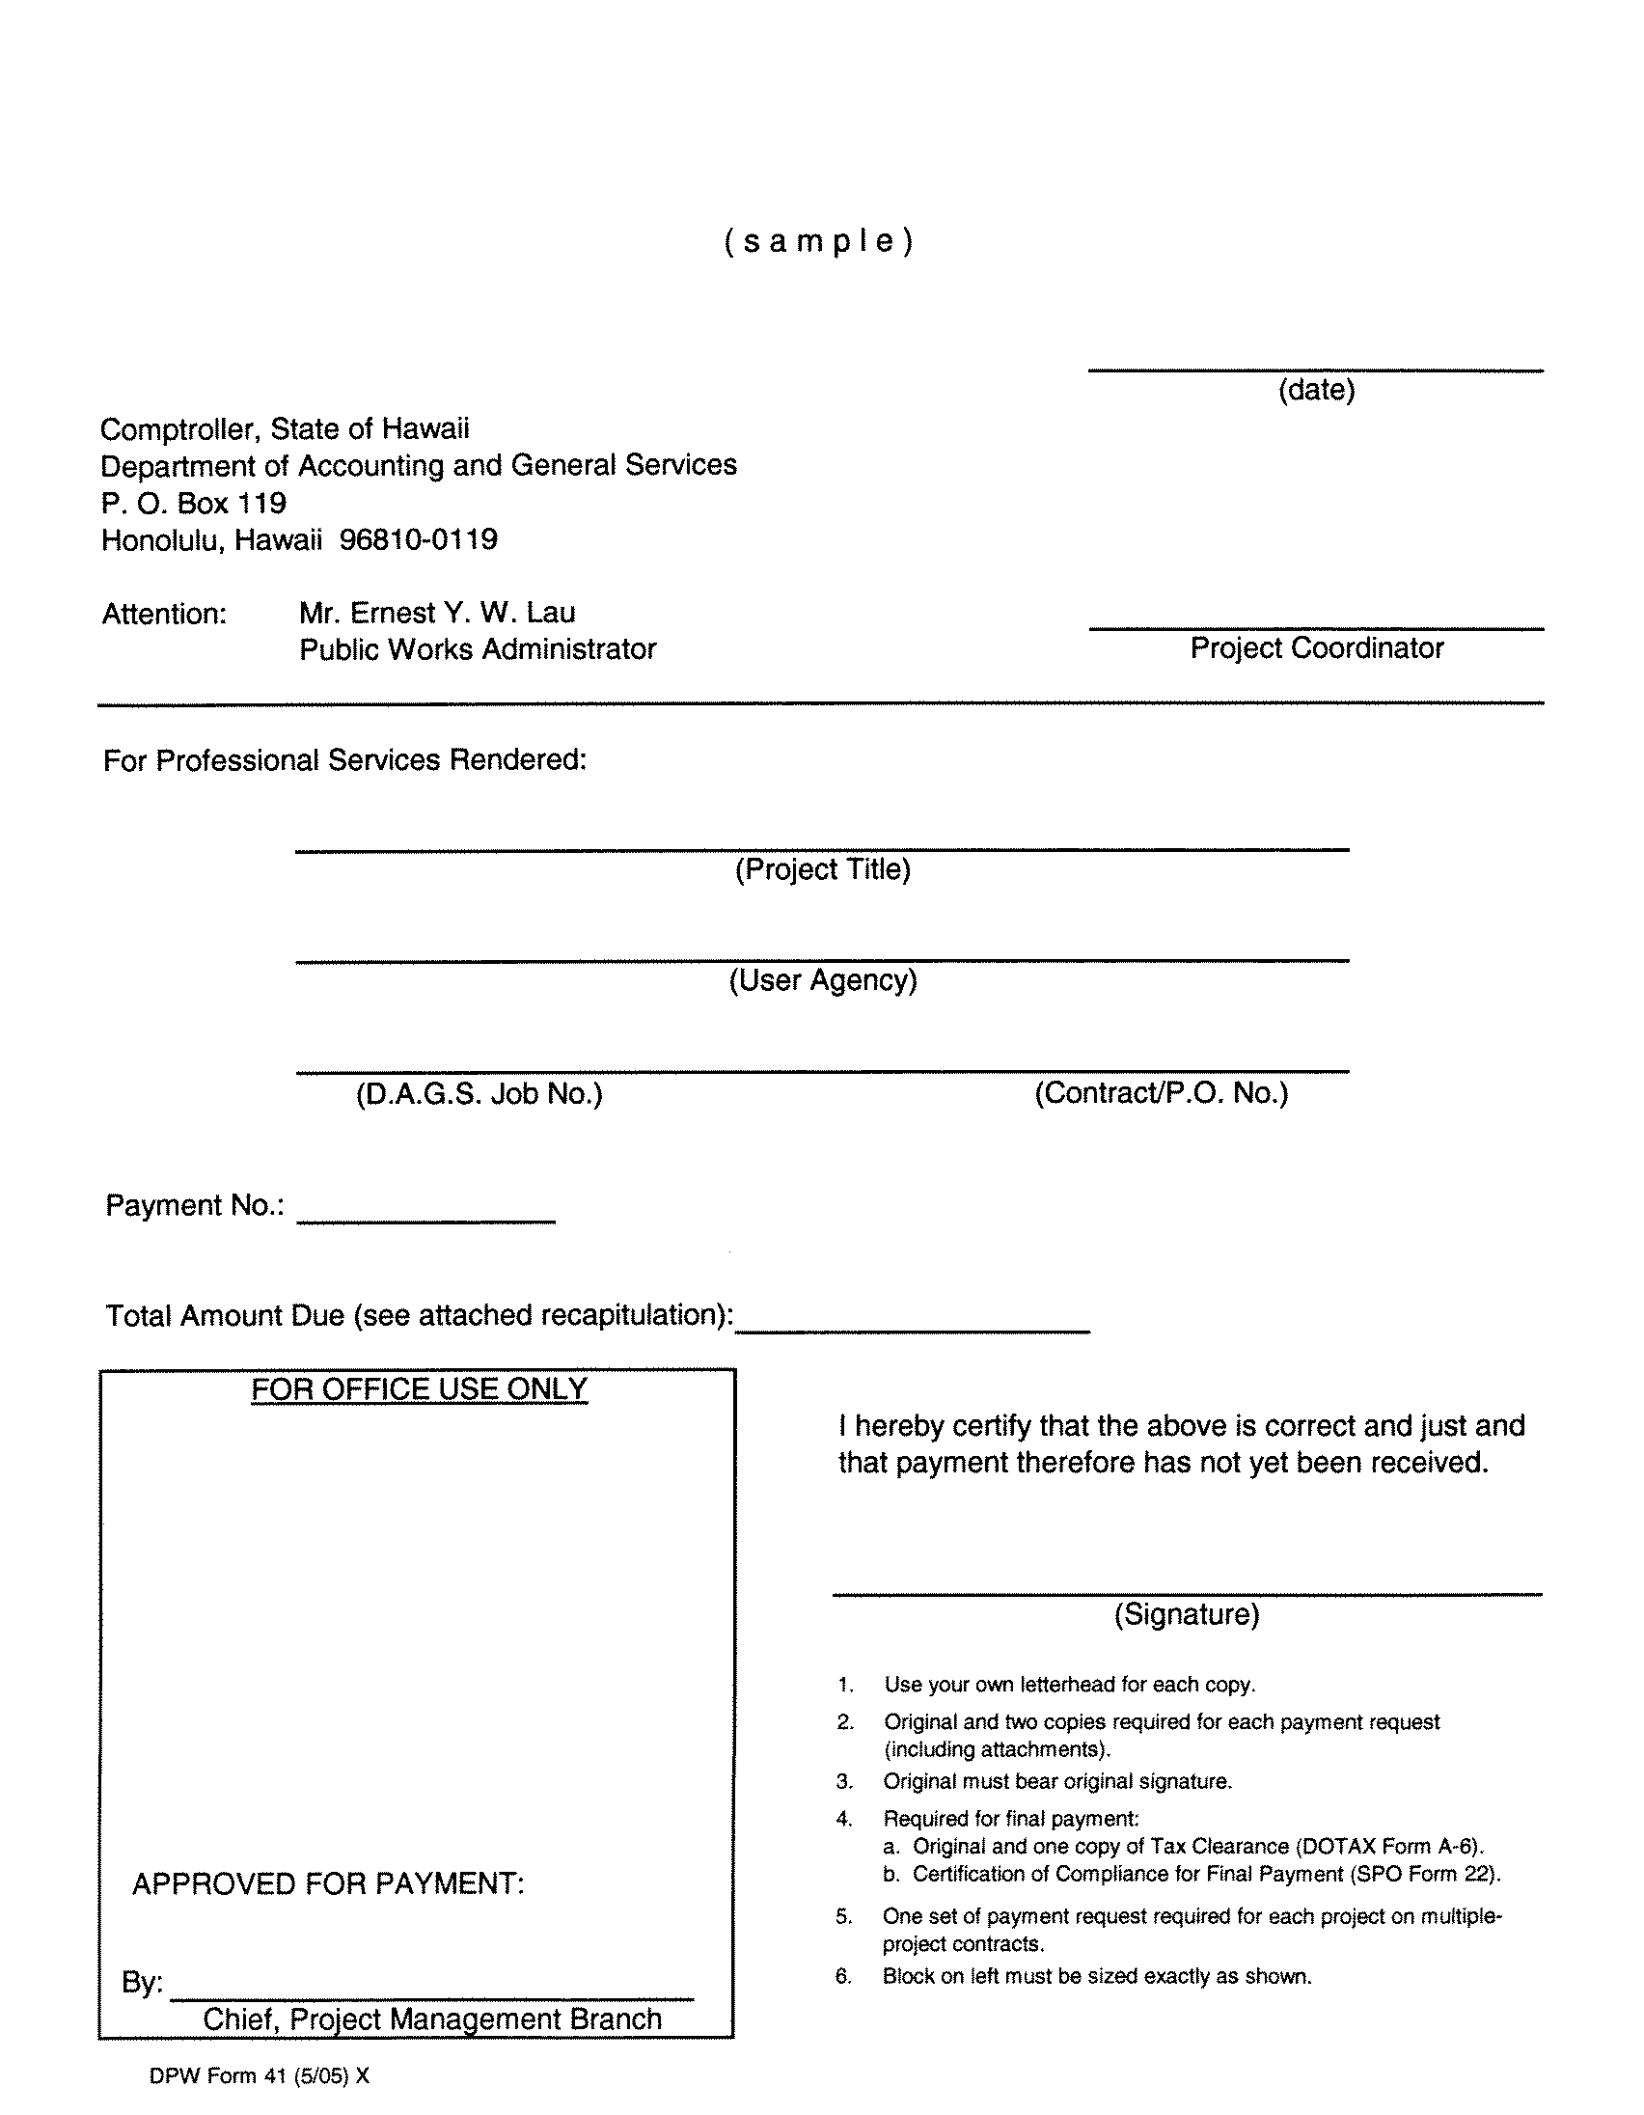
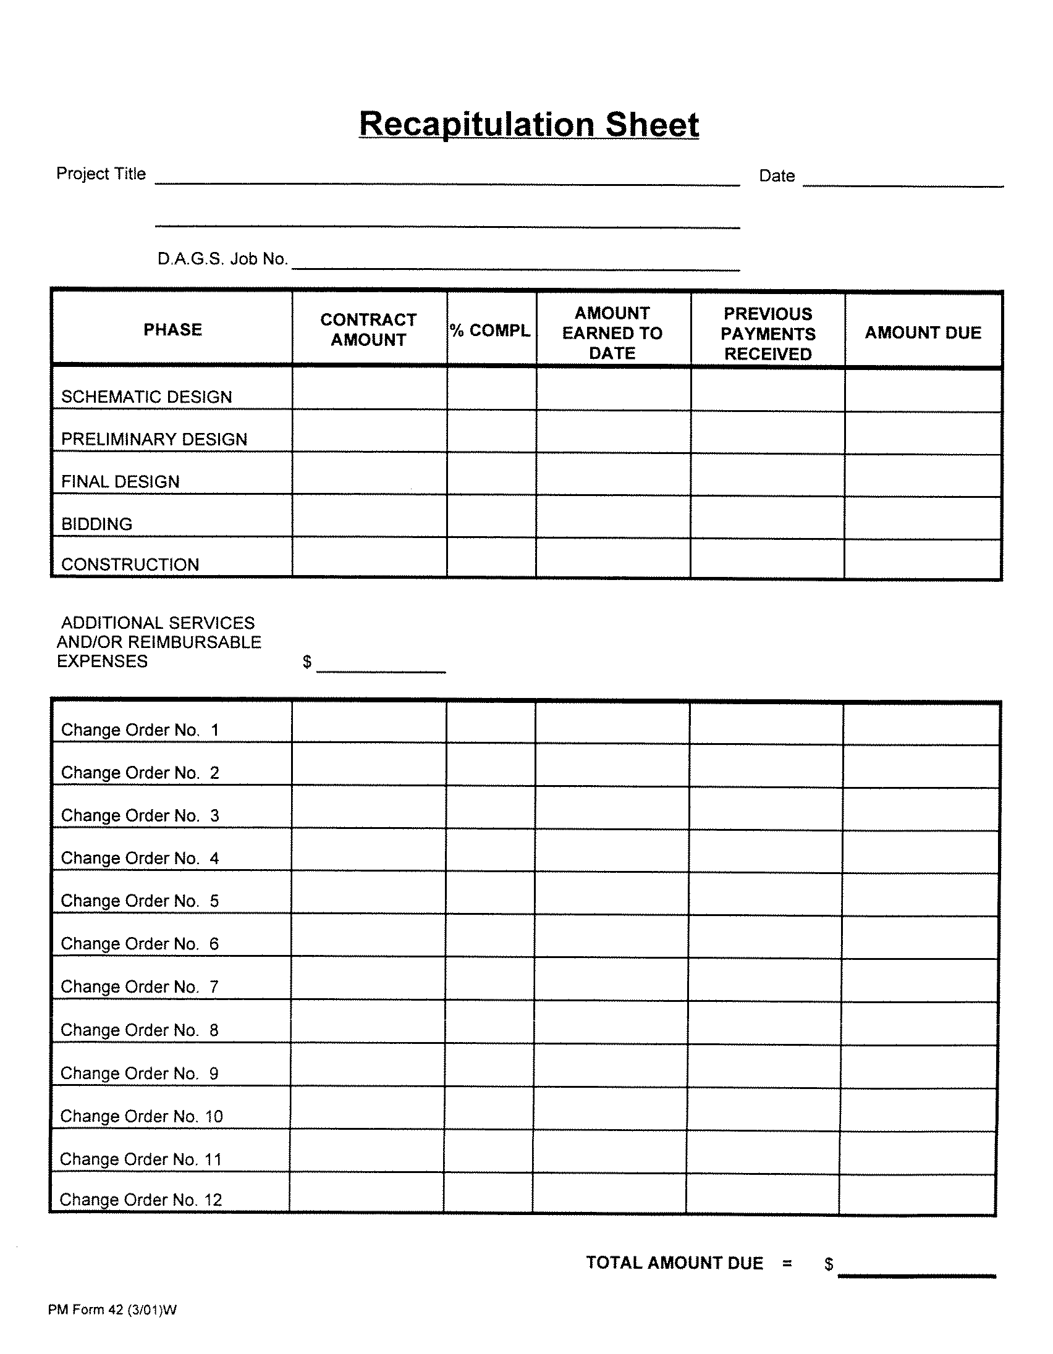
CIP PROJECT TRAINING
DAGS – Public Works Division
Payment Tracking

Slide 68
CIP PROJECT TRAINING
DAGS – Public Works Division
Payment Tracking

Slide 69
CIP PROJECT TRAINING
DAGS – Public Works Division
DESIGN PHASE
Q & A
MAHALO!

Slide 70
CIP PROJECT TRAINING
DAGS – Public Works Division
15 minute Break

Slide 71
Bidding PHASE
LLOYD OGATA
DAGS – PUBLIC WORKS
STAFF SERVICES OFFICE

Slide 72
ADVERTISEMENT, PRE-BID MEETING, BID OPENING DATES
The bidding phase of a project involves the following tasks:
Determine the contractor license required to bid on the project based on the contents of the plans and specifications and scope of work.
Set the dates for the advertisement, pre-bid meeting (if applicable), submittal of the Hawaii products preference, and bid opening (B.O.) using the following guidelines:
    The advertisement date must be at least 28 calendar days (4 weeks) prior to the B.O. date to allow bidders 14 days to review the plans and specifications and submit requests for information (RFIs) which are due 14 days prior to the B.O. date.

Slide 73
Post plans and specifications on the department’s website
b. If a pre-bid meeting is required, the date of the pre-bid meeting must be at least 15 calendar days prior to the B.O. date. A pre-bid meeting is required for all projects that have an estimated construction cost greater than or equal to $500,000.
c. The submittal date for the Hawaii products preference should be after the pre-bid meeting, at least 15 calendar days prior to the B.O. date.
3. The plans and specifications, addenda, and bid clarifications are posted as needed on the department's website.

Slide 74
Open bids and check the surety bid bonds that are attached
4. After the bids are opened, announce the name of the project and then read the basic bid amount and any additive alternate bid amounts submitted by each bidder.
a. If the bid is $25,000 or more, verify that a surety bid bond is attached and that it is for the correct project. If the bid bond is for a different project, the bid should automatically be rejected as non-responsive. Verify that the bidder and surety have each signed the bid bond and later check to be sure that they both have the authority to sign the bid bond. If either one failed to sign the bid bond, announce the defect at the bid opening.

Slide 75
POST THE TABULATION OF BIDS AND THE SUBCONTRACTORS LIST FOR THE LOWEST BID ON THE DEPARTMENT’S WEBSITE
b. Verify that the bidder has signed the bid form, that it is their original signature, and that it is in ink. If the bidder failed to sign the bid form, announce the defect at the B.O.
5. After the bids are opened and announced for the project, the tabulation of bids and the subcontractors list for the lowest bid are posted on the department's website.

Slide 76
CHECK THE BID FORM, BID BOND, AND SUBCONTRACTORS LIST FOR THE 4 LOWEST BIDS
6. The bid form and the bid bond for the lowest 4 bids are checked for conformance to legal requirements and, if required, letters are sent to reject or warn the bidders because of problems with their bid submittal. Go to the Department of Commerce & Consumer Affairs' (DCCA's) Professional & Vocational Licensing (PVL) Search website at https://pvl.ehawaii.gov/pvlsearch/ to verify that all of the required licenses for the contractors and their listed subcontractors are current and active. Based on the scope of work for the project, ensure that all of the required subcontractors have been listed for each contractor.

Slide 77
Resolve any bid protest and then award the construction contract
7. If a bid protest is received, the department is not to do anything that furthers the award of the construction contract until the bid protest has been resolved. Within 10 days of the final outcome of the protest, complete the Report on Procurement Protest (Form SPO-043) which can be found on the State Procurement Office's website at spo.hawaii.gov.
8. Upon receiving the recommendation for award from the project coordinator (PC), the construction contract and encumbrance forms are prepared, the award letter is sent to the contractor, and the award is posted on the department's website.

Slide 78
Determine the ntp date and then send a ntp letter
9. After the notice to proceed (NTP) date is agreed to by the PC, the Construction Management Branch, the contractor, and the user agency, a NTP letter is sent to the contractor indicating the contract amount, date of authorization to proceed, contract completion time, and completion date.

Slide 79
Mahalo

Slide 80
construction PHASE
(Final Draft)
DAGS – PUBLIC WORKS construction management branch
Eric k. Nishimoto acting branch chief construction management branch

Slide 81
CONSTRUCTION phase
PRE-CONSTRUCTION
NOTICE TO PROCEED, EXECUTION AND CONTROL OF CONSTRUCTION
ACCEPTANCE AND CLOSEOUT

Slide 82
CONSTRUCTION phase
PRE-CONSTRUCTION PHASE
  Award of Construction Contract
    Commencement Requirements
  Pre-con meeting
  Other meetings as necessary or required
  Understand the projects scope, budget, schedule and need date
  Re-assess project Risks

Slide 83
CONSTRUCTION phase
PRE-CONSTRUCTION PHASE
  Award of Construction Contract
    Upon Letter of Award:
      Execute contract, including performance and payment bonds
      Obtain construction permits and approvals
      Submit required submittals for review and approval
    If the above is not timely, it can affect the construction schedule

Slide 84
CONSTRUCTION phase
PRE-CONSTRUCTION PHASE
  Commencement Requirements – Prior to start of construction, Contractor shall:
    Pick-up and pay for any pre-processed permits/licenses
    Construction Schedule
    Schedule of Prices
    Proof of Insurance Coverage (include State as Add’l Insured)
  No work allowed until the above is obtained, unless approved by the Contracting Officer

Slide 85
CONSTRUCTION phase
PRE-CONSTRUCTION PHASE
  Construction Schedule
    Purpose is to monitor the Contractor’s progress of work
    Should include normal inclement weather, soil conditions, other conditions that may affect the work
    Schedule and coordination required by any utility including OneCall.
    Fabrication and delivery of materials
    All other pertinent factor that relate to the progress of construction
  Schedule of Prices
    Purpose: Used to determine the value of monthly payments due to the contractor for work completed (Track payments due)
    May also be used as a basis for determining cost for added or deleted work

Slide 86
CONSTRUCTION phase
PRE-CONSTRUCTION PHASE
  Pre-con meeting
    Purpose: For procedural and coordination
    Typical Attendees: Contracting Agency, User Agency Rep., End User Rep., and Contractor.
    Other Attendees: Design Consultant, Other User Agency Rep.
  Other meetings as necessary or required
    Project may require meeting with other Stakeholders
    Coordination of known changes forthcoming

Slide 87
CONSTRUCTION phase
NTP, EXECUTION AND CONTROL OF CONSTRUCTION
  NTP: Typically, issued only after all pre-processed type permits and applications have been approved
  Contractor has met, obtained and submitted all commencement requirements necessary to start construction
  Construction Project Schedule
  Submittals Required
  Coordination and Communication
  Changes
  Monthly Payments
  Continue to re-assess project risks

Slide 88
CONSTRUCTION phase
NTP, EXECUTION AND CONTROL OF CONSTRUCTION
  Construction Project Schedule
    Upon NTP: Contractor should update schedule based on actual NTP date and must be approved/agreed to by Contracting Officer
    Updated schedule required to be within contract time
    Schedule must be updated as construction progresses. Must be approved/agreed to by Contracting Officer
      Three week look ahead schedule by contractor
    If in the opinion of the Contracting Officer, the Contractor behind, the Contractor shall take steps, including additional workdays, overtime, etc. to improve the progress with no additional cost to the State

Slide 89
CONSTRUCTION phase
NTP, EXECUTION AND CONTROL OF CONSTRUCTION
  Submittals Required
    Submittal Logs:
      Shop Drawing
      Material & Equipment
    Other submittals required necessary for the progress of construction, such as with utilities
    Track outstanding submittals not submitted and/or not approved

Slide 90
CONSTRUCTION phase
NTP, EXECUTION AND CONTROL OF CONSTRUCTION
  Coordination and Communication
    Owner, Architect, Contractor meeting
    Other meetings
    Stakeholder meetings
    Communication to general public

Slide 91
CONSTRUCTION phase
NTP, EXECUTION AND CONTROL OF CONSTRUCTION
  Changes
    Types of changes:
      Unforeseen conditions
      User requested changes
      Design improvements
      Design errors and/or omission
      Permit related
      Other

Slide 92
CONSTRUCTION phase
NTP, EXECUTION AND CONTROL OF CONSTRUCTION
  Changes
    Changes can affect the scope, budget, schedule
    Change scope must be within authorized purpose of the funding
    Cost of change must be within budget or available funds, and for a fair and reasonable price
    Time required to do the change must be addressed

Slide 93
CONSTRUCTION phase
NTP, EXECUTION AND CONTROL OF CONSTRUCTION
  Changes
    Authorization for Change
      Describes the problem
      Recommends a solution
      Estimates the cost of the proposed change
      Estimates the time impact of the proposed change

Slide 94
CONSTRUCTION phase
NTP, EXECUTION AND CONTROL OF CONSTRUCTION
  Monthly Payments
    Progress payments
      Monthly Estimate
      Retainage Calculation
      Monthly Construction Progress Report
      Statement of Contract Time
      Current on Daily Logs
      Current on Payroll Affidavits
      Updated Schedule
      Updated Submittal Register
      Verification of Statement of Contract Time – If more than 15% behind schedule

Slide 95
CONSTRUCTION phase
NTP, EXECUTION AND CONTROL OF CONSTRUCTION
  Monthly Payments
    Prompt payments
      Contractor payments posted on DAGS Public Works Division Website
    Tracking of payments on internal database

Slide 96
CONSTRUCTION phase
ACCEPTANCE AND CLOSEOUT
  Substantial Completion
  Final Inspection
  Project Acceptance
  Final Payment and Final Settlement

Slide 97
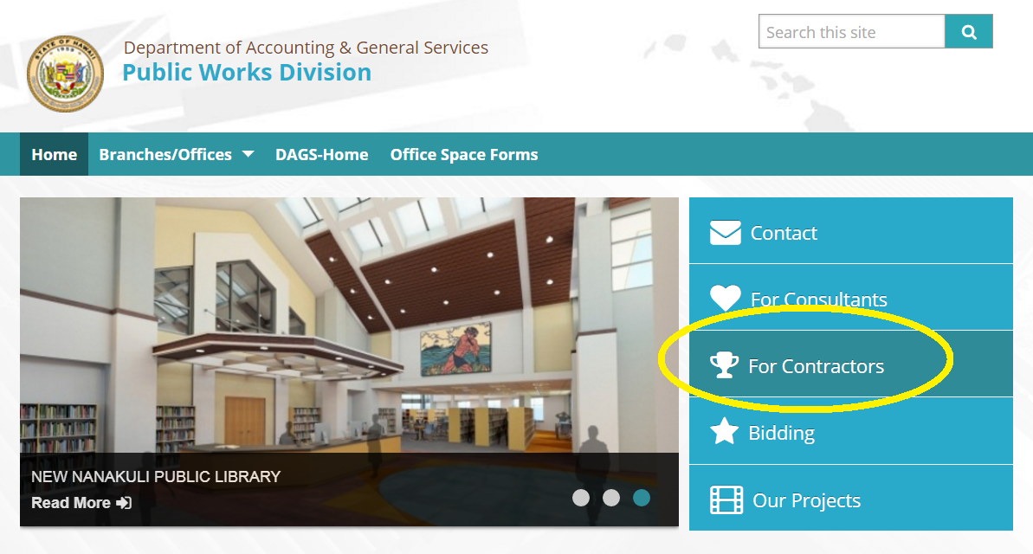
http://pwd.hawaii.gov/

Slide 98
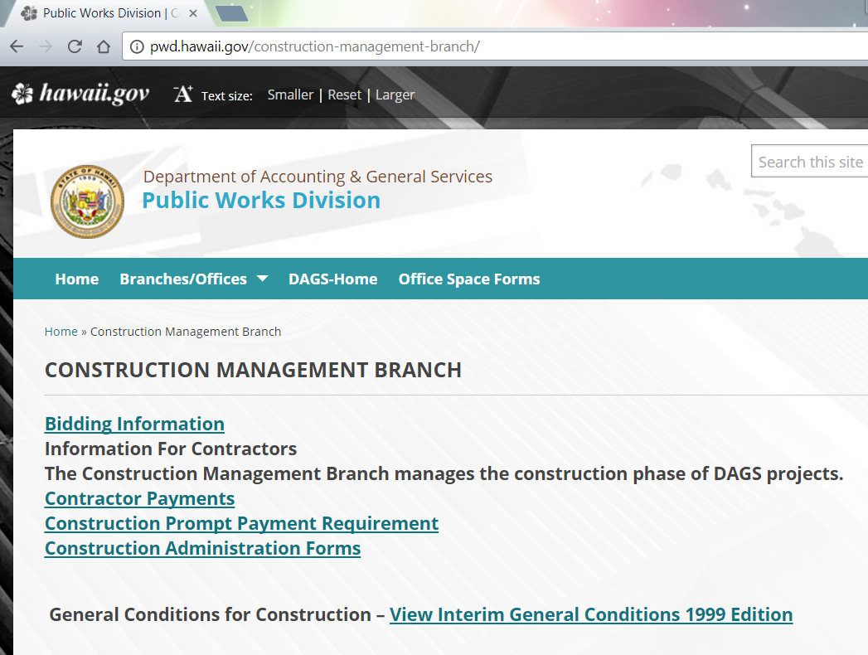

Slide 99
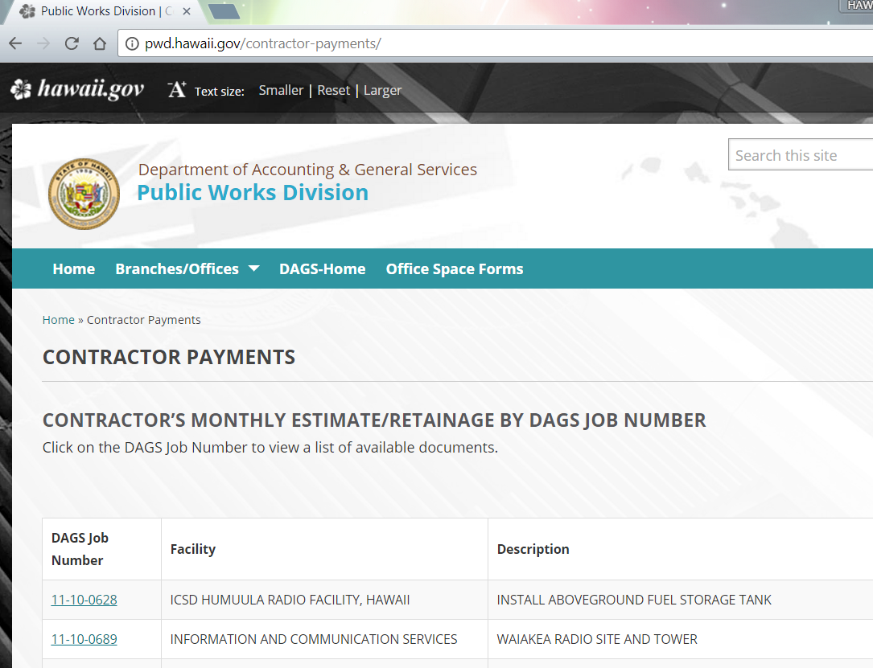

Slide 100
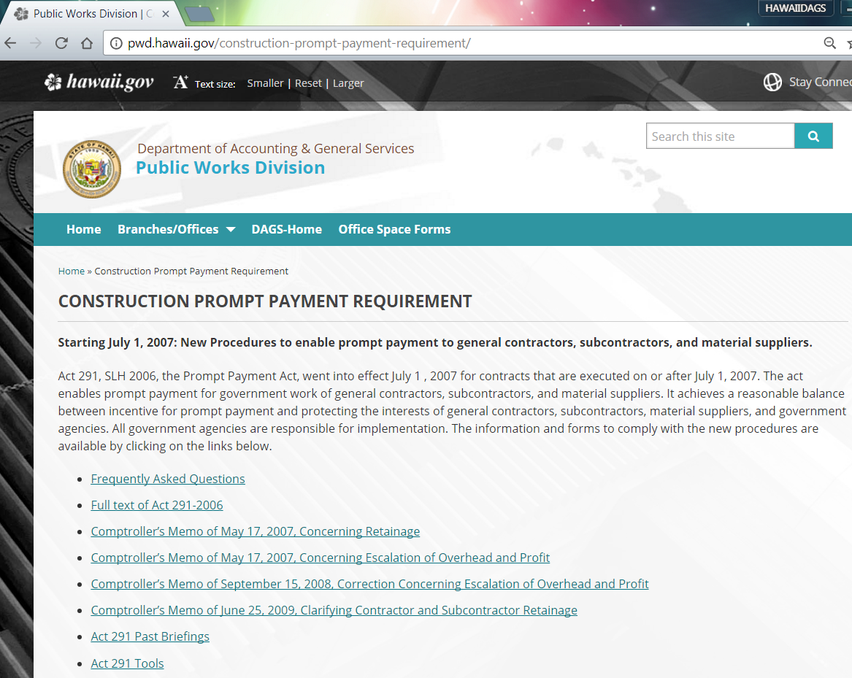

Slide 101
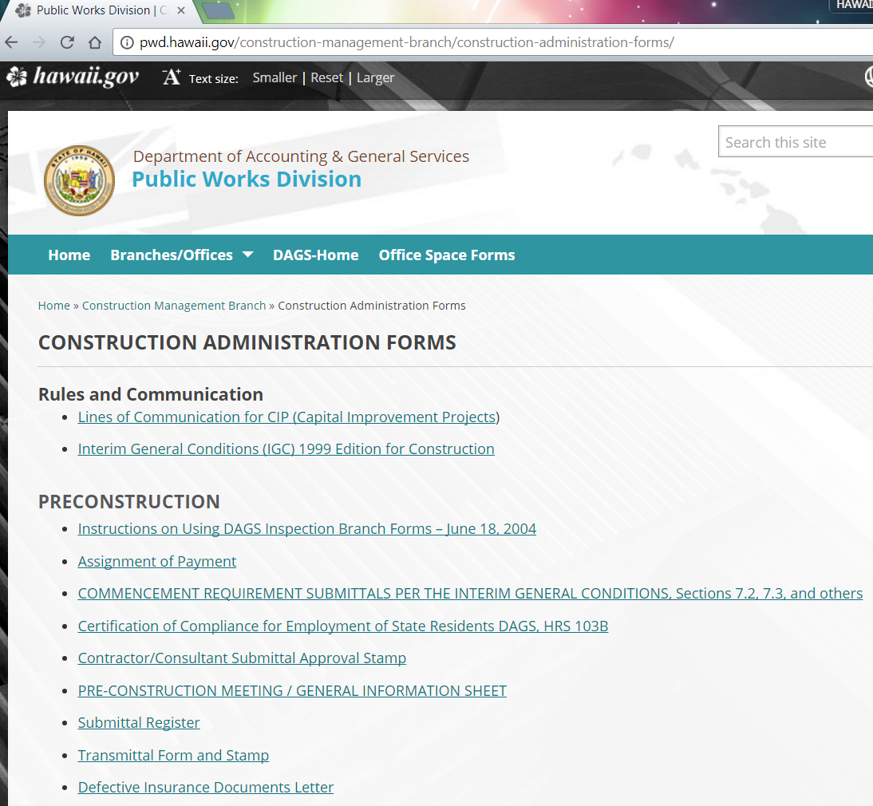

Slide 102
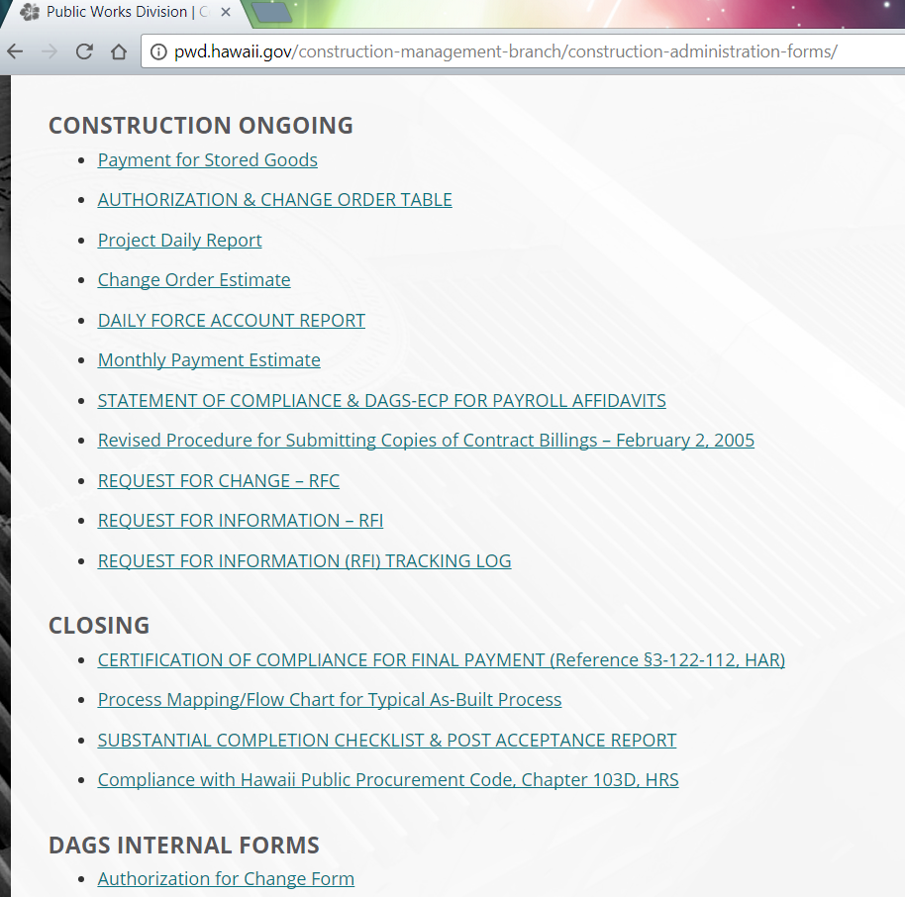

Slide 103
Mahalo
Questions & answers

Slide 104
POST-construction
Scott Ojiri dags – public works

Slide 105
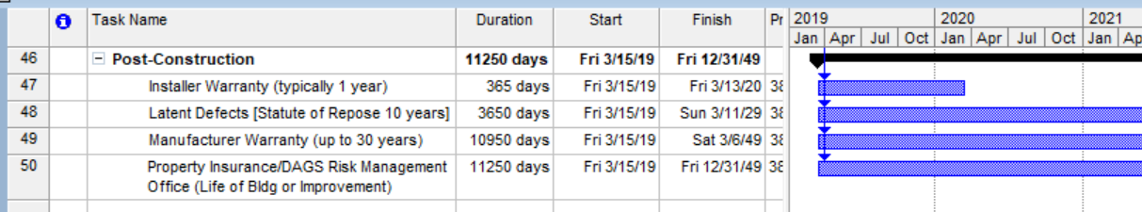
Post-construction

Slide 106
Warranties
Contractor(Installer) Warranty: Typically 1 year from project acceptance date.
Manufacturer Warranty: Typically also 1 year, up to 30 years
  Flashing/Sheetmetal: 2 years
  Finish Systems (Acoustical Systems, Wall Panels, Insulation): 2 years
  Rooftop Mechanical Systems: Up to 10 years
  Exterior Windows: Up to 10 years
  Fire rated doors/assemblies: Up to 10 years
  Roofing: Up to 30 years

Slide 107
Warranties
Records: Contract Documents, Warranty certificates, Acceptance Letters.
Database of long-term warranty items

Slide 108
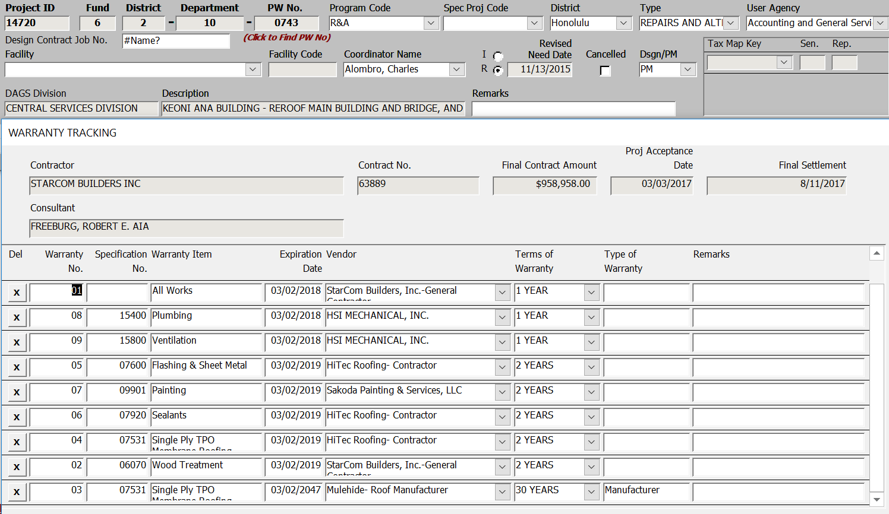
WARRANTY DATABASE

Slide 109
Latent Defects
  A Patent Defect is one that is detectable either at or before apparent practical completion or during the defects liability period. In the past, the courts have held that patent defects must be apparent on inspection but need not necessarily have been seen by the people carrying out that inspection.
  Latent Defect is one which has been concealed in the works and may not become apparent for many years.
    Defective water proofing.
    Inadequate wind-posts or wall ties causing movement damage to walls.
    Under-strength concrete or misplaced reinforcement allowing movement damage to the structure.
    Inadequate foundations causing subsidence of the building.
  Claims: Designer, Constructor, Manufacturers, Project Manager.

Slide 110
Statute of repose: 10 years
Statute of limitations: 2 years
  §657-8 Limitation of action for damages based on construction to improve real property.
  (a) No action to recover damages for any injury to property, real or personal, or for bodily injury or wrongful death, arising out of any deficiency or neglect in the planning, design, construction, supervision and administering of construction, and observation of construction relating to an improvement to real property shall be commenced more than two years after the cause of action has accrued, but in any event not more than ten years after the date of completion of the improvement.
  (b) This section shall not apply to actions for damages against owners or other persons having an interest in the real property or improvement based on their negligent conduct in the repair or maintenance of the improvement or to actions for damages against surveyors for their own errors in boundary surveys. The term "improvement" as used in this section shall have the same meaning as in section 507-41 and the phrase "date of completion" as used in this section shall mean the time when there has been substantial completion of the improvement or the improvement has been abandoned. The filing of an affidavit of publication and notice of completion with the circuit court where the property is situated in compliance with section 507-43(f) shall be prima facie evidence of the date of completion. This section shall not be construed to prevent, limit, or extend any shorter period of limitation applicable to sureties provided for in any contract or bond or any other statute, nor to extend or add to the liability of any surety beyond that for which the surety agreed to be liable by contract or bond.
  (c) Nothing in this section shall exclude or limit the liability provisions as set forth in the products liability laws.

Slide 111
Latent Defects
  Could be difficult to prove without appropriate documentation.
    Concrete slab moisture problems with floor covering
    Underground water line breaks
    Window glass cracking
  Keep accurate records. Submittals, shop drawings, inspection reports, etc.

Slide 112
PROPERTY INSURANCE
    Different from the insurance in your design and construction contracts.
    Policy Purchased by DAGS Risk Management Office
    Covers things like wind and water damage, accidents, in addition to fire, theft, etc. (Must be fortuitous or accidental)

Slide 113
Property insurance: DOES NOT COVER
    Ordinary wear & tear or gradual deterioration
    Failure to maintain
    Faulty design, material, or workmanship
    Fraudulent acts, hostile or warlike action, etc.

Slide 114
Property insurance
DAGS RISK MANAGEMENT OFFICE
      http://ags.hawaii.gov/aso/rmo
      Telephone number is 586-0547
      E-mail address: dagsrmo@hawaii.gov.

Slide 115
Post-construction
      Questions?

Slide 116
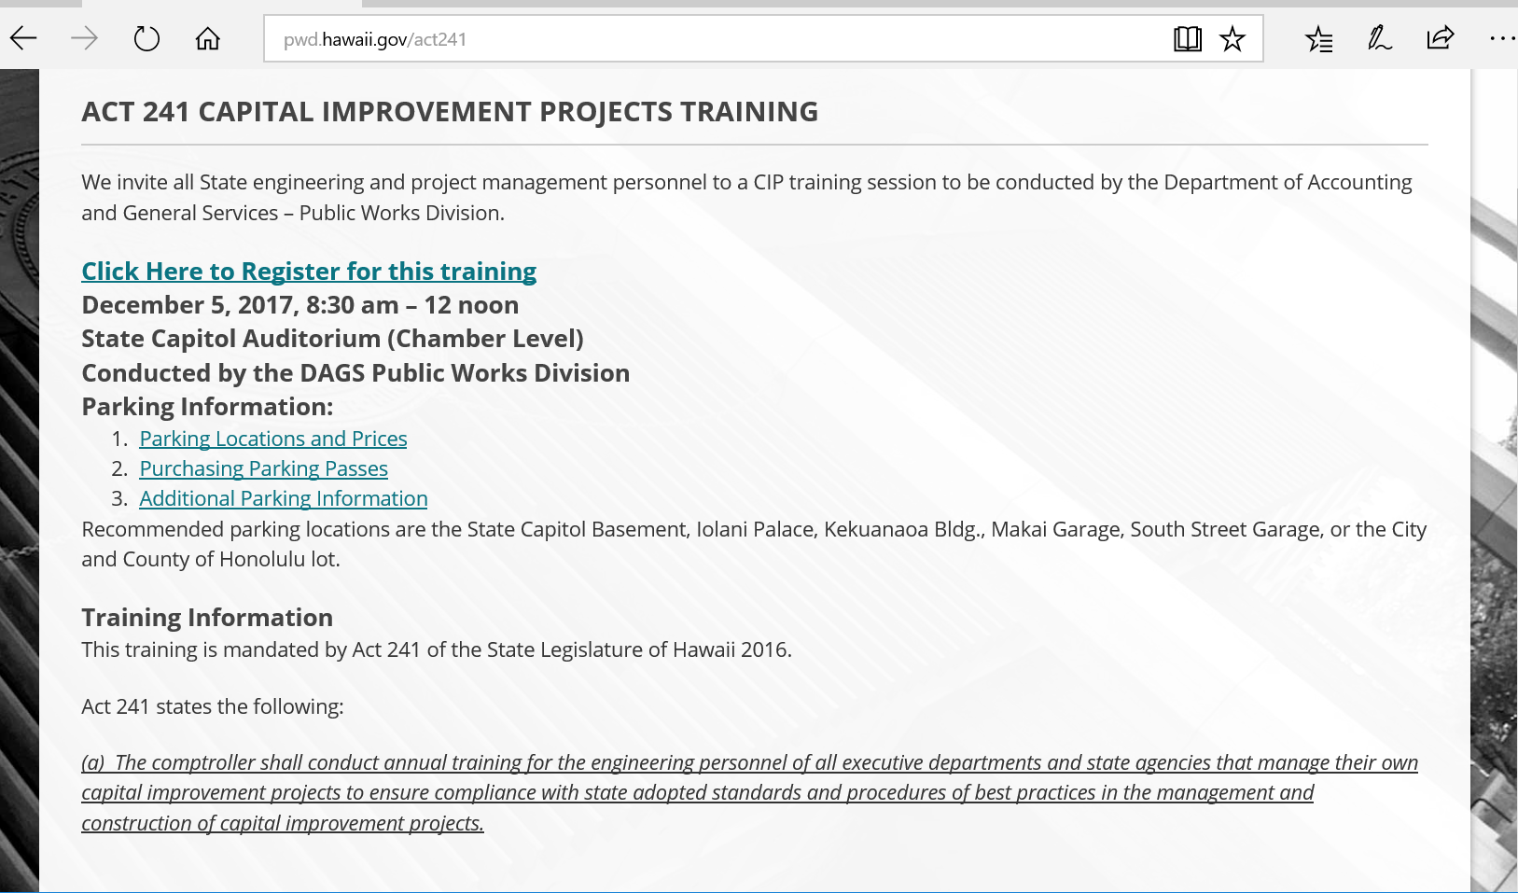
ACT 241 WEB SITE
Act 241 requires each Department to provide their own training for new employees as an orientation.
Video of this training will be available some time in January 2018.
  http://pwd.hawaii.gov/act241

Slide 117
Act 241 Capital improvement projects training
      Questions?

Slide 118
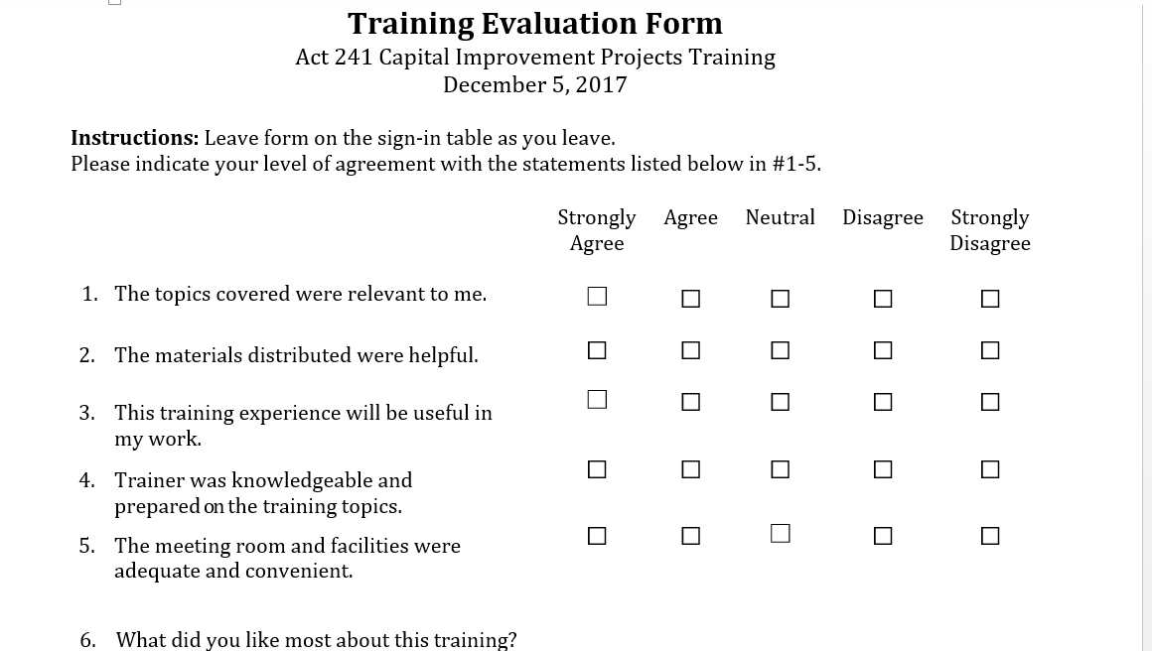
Training evaluation form

Slide 119
acknowledgments
      Other Departments/agencies contributing to this training
      UH - James Kurata.
      DOD - Lloyd Maki, Neal Mitsuyoshi
      DOT Airports - Jeff Chang
      DOE - Duane Kashiwai
      DHS, Hawaii Public Housing - Becky Choi.
      DHHL - Jeffrey Fujimoto.
      DOT Admin - James Fu
      DOT Highways - Scot Urada, Ross Hironaka, Alex Oshiro
      Judiciary - Joanne Krippaehne
      DLNR - Kaiwi Yoon, Russell Takara, Dina Lau
      Enterprise Technology Services (ETS)
      House Sergeant-at-Arms

Slide 120
CLOSING REMARKS
Act 241 Capitol Improvement Projects Training 2017
By Department of Accounting and General Services

Slide 121
MAHALO
Act 241 Capitol Improvement Projects Training 2017
By Department of Accounting and General Services

